Slide 1
CMPE 273 Project Presentation
Team: GreenApple

Slide 2
About the project ...
Amazon Echo-enabled Pizza Ordering System
This project enables you to order pizza by giving voice input to alexa.
Alexa then uses information from its skills set and asks the user for further inputs to complete the order.

Slide 3
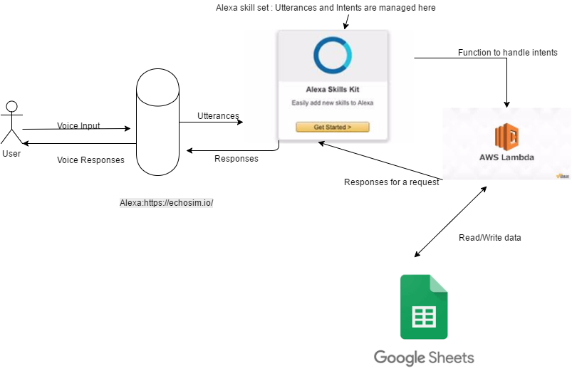
ARCHITECTURE

Slide 4
Input from the user
The input is given in the voice form at:
https://echosim.io/

Slide 5
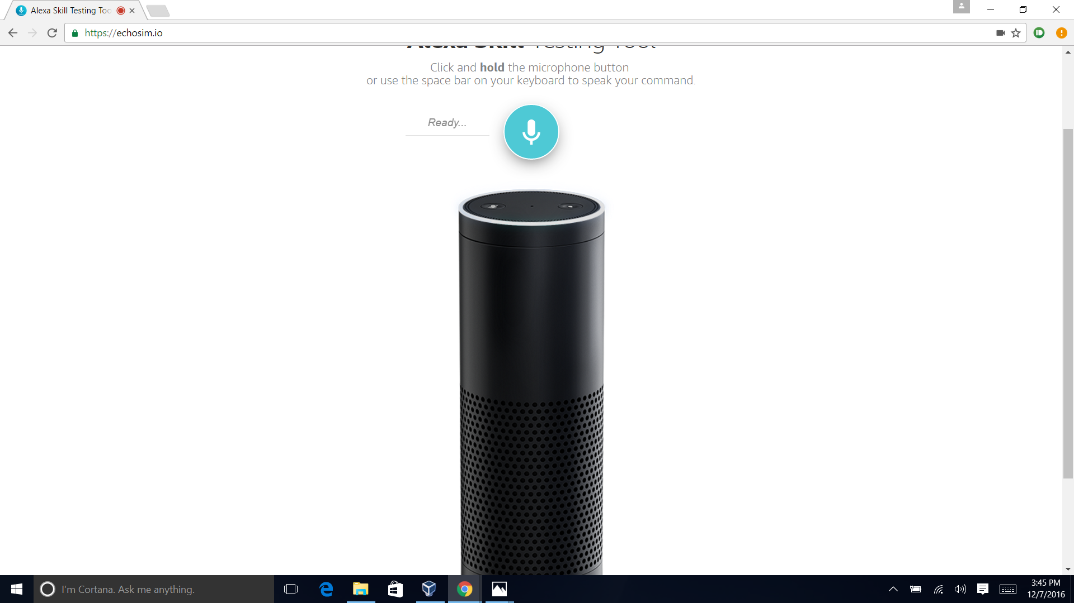

Slide 6
The Working...
Alexa maps the utterances (voice input from user) to its corresponding intents.
The intents are further handled in the AWS lambda function.
The aws lambda function:
Retrieves the data requested from the google sheet using google sheet API.
Writes the customer order to the google sheet using google sheet API.

